Slide 1

DATAFORGE – INTELLIGENT ETL & DATA QUALITY PLATFORM FOR MANUFACTURING
Fundamentals of Data Engineering- 24DEA3101R
Submitted by:
V. Preetham Nikil - 2420030302
V .Chandra - 2420030291
G. Khethana – 2420030461
Team No: 11
Section: 7
Under the Guidance of:
Dr. N Shirisha
Associate Professor
KLH University Hyderabad
Bowrampet, Bachupally – 500090
Telangana, India

Slide 2
  Manufacturing organizations generate data from production, machines, inventory, maintenance, and quality inspection.
  Earlier, this data was stored in separate systems and required manual processing.
  This caused problems such as missing values, duplicate records, inconsistent formats, and invalid data.
Automated ETL: Successfully automated the extraction, transformation, and processing of manufacturing data.
Data Quality: Detected missing, duplicate, inconsistent, and invalid records through automated validation.
Quality Improvement: Improved demonstrated data quality from 91.3% to 100%.
Invalid Record Detection: Increased invalid-record detection from 4.3% to 12.8% compared with the existing approach.
Processing Performance: Achieved 60.6 K records/min throughput and 1.50 sec/1K records processing time.
Reliable Output: Produced clean, validated, and analytics-ready manufacturing data.
ABSTRACT

Slide 3
INTRODUCTION
  Manufacturing organizations generate large amounts of data from production, machine sensors, inventory, maintenance, and quality inspection.
  Previously, this data was stored in different systems and different formats, making it difficult to manage and combine.
  The existing approach often required manual data collection and processing.
  This resulted in problems such as:
  Missing values
  Duplicate records
  Inconsistent data formats
  Invalid measurements
  Difficulty in integrating data from different departments

Slide 4
  Manufacturing was chosen for this project because it generates large volumes of important operational data, and reliable data is necessary for efficient operations and decision-making.
  DataForge is introduced to overcome these problems by bringing manufacturing data into a single intelligent platform.
  The project uses:
  ETL for extracting and transforming data
  Apache Kafka for real-time data ingestion
  Apache PySpark for scalable data processing
  Automated Data Quality Checks for identifying and handling data errors
  The main change brought by DataForge is the transformation of scattered and unreliable data into centralized, clean, validated, and analytics-ready data.
  Final Outcome: The platform reduces manual effort, improves data quality and reliability, and helps manufacturing organizations make accurate data-driven decisions.

Slide 5
Problem
  Manufacturing data comes from multiple internal sources and formats.
  Raw data may contain missing values, duplicates, inconsistencies, and invalid records.
  Real-time machine data requires continuous and efficient processing.
  Manual data cleaning is time-consuming and error-prone.
  Poor-quality data can lead to inaccurate analysis and decisions.
Outcome
  Automated and scalable manufacturing data processing.
  Improved data quality, consistency, and reliability.
  Reduced manual data-cleaning effort.
  Real-time processing of machine and production data.
  Provides clean and validated data for analysis and reporting.
  Supports better data-driven manufacturing decisions.
Main Technologies
Python → Apache Kafka → Apache PySpark → Data Quality Validation → MySQL
Simple Pipeline
Internal Manufacturing Data → Kafka → PySpark ETL → Data Quality Checks → MySQL → Analytics/Reports

Slide 6
Objectives
  Integrate manufacturing data from multiple departments into one platform.
  Automate the process of collecting and processing manufacturing data.
  Improve Data Quality by detecting missing, duplicate, inconsistent, and invalid data.
  Enable Real-Time Processing using Apache Kafka.
  Handle Large-Scale Data efficiently using Apache PySpark.
  Create a Reliable Centralized Dataset for analytics and reporting.
  Reduce Manual Effort and improve the speed of data processing.
  Support Better Decision-Making using accurate and high-quality manufacturing data.

Slide 7
Literature survey
Paper Link | Authors | Drawbacks | Future Work
Paper Link | Peter O'Donovan Kevin Leahy Ken Bruton Dominic T. J. O'Sullivan | The study provides a broad mapping of the research area but sacrifices detailed depth. Manufacturing big-data research was still relatively immature. There was a high proportion of theoretical/philosophical research and comparatively limited rigorous evaluation of practical solutions. | More real-world implementation and evaluation of big-data technologies in manufacturing. Development of mature platforms and validated manufacturing applications.
Paper Link | Yesheng Cui Sami Kara Ka C. Chan | The review found no enterprise-ready big-data solution covering the complete manufacturing ecosystem. Manufacturing systems have heterogeneous interfaces, protocols, and data definitions. Several important manufacturing areas received less research attention. | Connectivity and interoperability Standardized big-data platform design Real-time big-data analytics Modelling and simulation Cybersecurity
Paper Link | Arda Goknil Phu Nguyen Sagar Sen Dimitra Politaki Harris Niavis Karl John Pedersen | Limited research explains the sources and causes of data-quality problems. Very few studies report the practical adoption of data-quality metrics in industrial systems. Some data-repair techniques have limitations in industrial CPS/IoT environments. | Develop better techniques based on the causes of data-quality problems. Study the impact of different computing architectures. Increase practical adoption of data-quality metrics in industrial environments.

Slide 8
Paper Link | Teresa Peixoto, Óscar Oliveira, Eliana Costa e Silva, Bruno Oliveira, Fillipe Ribeiro | The implementation was evaluated in a specific real manufacturing scenario. The reported case used a particular sensor/data setup, so broader validation is still needed. | Evaluate the effect of data-quality monitoring on decision-making, production stability, and maintenance planning. Validate the pipeline in different industrial scenarios.
Paper Link | Altan Cakir, Özgün Akın, Halil Faruk Deniz, Ali Yılmaz | Uses a complex big-data infrastructure with multiple components. • Requires significant hardware and infrastructure resources. • The case study focuses on a specific plastic injection manufacturing environment. | Further develop machine-learning and anomaly-detection solutions. Scale the infrastructure as data volume and connected devices increase.
Paper Link | Ikbal Taleb, Mohamed Adel Serhani, Rachida Dssouli | 1. Broad survey rather than a complete implementation. 2. Quality techniques may vary across different big-data platforms. 3. Limited practical validation in real-time systems. | Develop automated quality monitoring. Apply quality management across the complete data lifecycle. Improve real-time big-data quality assessment.
Paper Link | Ikbal Taleb, Mohamed Adel Serhani, Chafik Bouhaddioui, Rachida Dssouli | 1. Data quality at the data-inception stage is not fully considered. 2. Framework requires additional implementation and validation. 3. Quality management can be complex in large distributed environments. | Include data quality from data generation/inception. Develop automated quality feedback mechanisms. Validate the framework with different real-world datasets.

Slide 9
Paper Link | H. Y. Teh, A. W. Kempa-Liehr, K. I. K. Wang | Develop generalized sensor-quality methods. Improve real-time error detection and correction. Integrate quality checking with big-data platforms such as Spark and Kafka | 1.Sensor data can contain missing, noisy and corrupted values. 2. Different sensors require different quality techniques. 3. Many approaches are difficult to apply across heterogeneous systems.
Paper Link | Aimad Karkouch, Hajar Mousannif, Hassan Al Moatassime, Thomas Noël | Develop IoT-specific automated data-cleaning methods. Improve real-time quality monitoring. Develop scalable quality solutions for large IoT deployments. | 1. IoT data is highly heterogeneous. 2. Sensor data can contain outliers and inconsistencies. 3. Existing cleaning techniques may not work equally well for all IoT applications.
Paper Link | Lisa Ehrlinger, Wolfram Wöß | Improve automated data-quality monitoring. Develop standardized quality metrics. Integrate profiling and monitoring directly into data-engineering pipelines. | 1. Only a limited number of tools provide complete profiling, measurement and monitoring capabilities. 2. Data-quality metrics are not consistently implemented across tools. 3. Tool capabilities vary between commercial and open-source solutions.

Slide 10
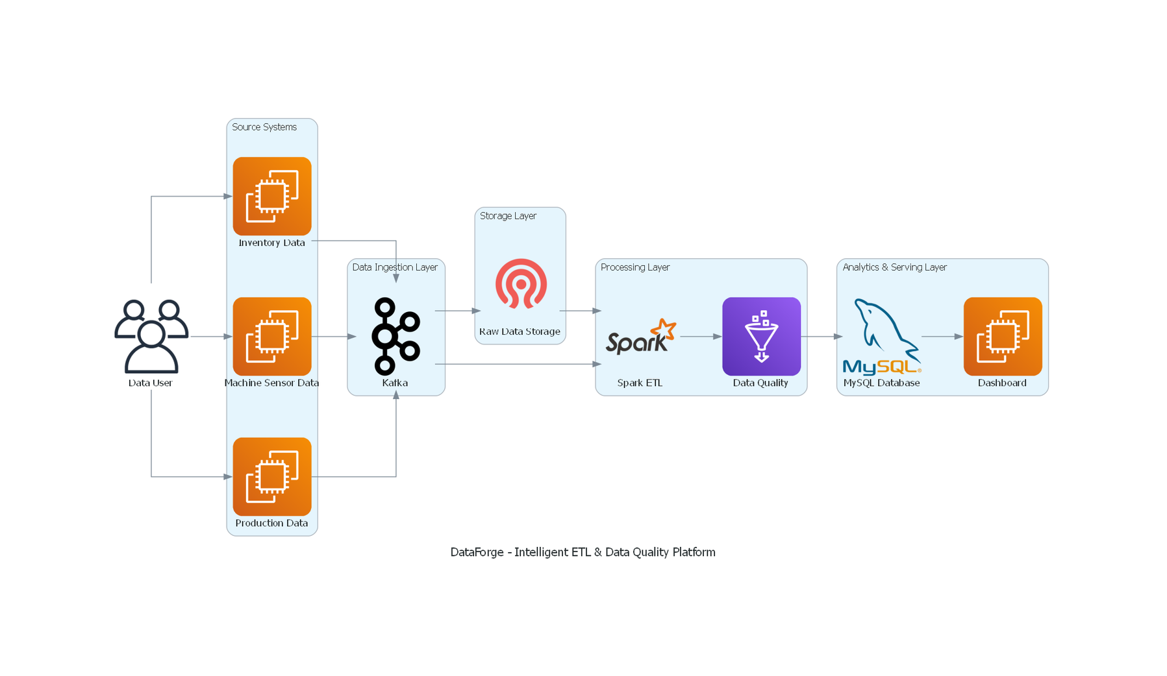
System Design

Slide 11
Architecture
• Data Sources : Production records, machine sensors, inventory & maintenance logs
• Kafka : Real-time data ingestion
• Spark / PySpark : Data processing & transformation
• Great Expectations : Data quality validation
• MySQL / Parquet : Cleaned & processed data storage
• Scikit-learn : Anomaly detection
• FastAPI : Backend API
• Dashboard / Grafana : Data visualization & monitoring
Overall Flow:
Data Sources → Kafka → Spark / PySpark → Data Quality → Storage & Anomaly Detection → FastAPI → Dashboard / Grafana

Slide 12
Methodology
Existing Methodology | Proposed DataForge Methodology
General data collection | Focused on one manufacturing organization
Manual data ingestion | Python-based automated ingestion
Batch processing | Batch + real-time data processing
Basic data cleaning | Automated data cleaning
Limited data validation | Automated data quality checks
Manual duplicate detection | Automatic duplicate detection
No dedicated streaming layer | Apache Kafka for data streaming
Data stored after processing | Only validated data stored in MySQL

Slide 13
Technology stack
Category | Tools | Purpose
Programming | Python, PySpark | Pipeline development and distributed data processing
Data Ingestion | Apache Kafka | Real-time manufacturing data ingestion and event streaming
Stream Processing | Spark Structured Streaming | Real-time processing and transformation of manufacturing data
Data Quality | Great Expectations | Data validation, profiling, and quality checks
Data Lake | MinIO (S3-Compatible) | Scalable storage for raw and processed manufacturing data
Data Storage | Apache Parquet, MySQL | Efficient analytical storage and structured data persistence
Machine Learning | Scikit-learn | Anomaly detection in manufacturing data
API Layer | FastAPI | Backend APIs for data and anomaly detection services
Monitoring | Grafana | Pipeline, system, and data quality monitoring
DevOps & Version Control | Docker, Git | Containerization, deployment, and source-code management

Slide 14
Use of Modern Tools & Technologies
  Real-time Processing: Uses Kafka and Spark Structured Streaming for continuous and low-latency manufacturing data processing.
  Automated Data Quality: Great Expectations enables systematic validation, profiling, and quality checks on manufacturing data.
  Scalable Data Management: MinIO, Parquet, and MySQL support efficient storage of raw, cleaned, and processed data.
  Machine Learning Integration: Scikit-learn is used for detecting anomalies in manufacturing data.
  API-Based Architecture: FastAPI enables communication between backend processing, analytics, and the dashboard.
  Containerized Development: Docker supports consistent deployment and environment management.
  Monitoring & Visualization: Grafana provides monitoring of data pipelines, data quality, and system performance.

Slide 15
Production vs Laptop Demo
REAL DEPLOYMENT
Manufacturing Sources
↓
Kafka
↓
PySpark
↓
Data Quality
↓
MySQL
LAPTOP DEMO
Generated Dataset
↓
FileBus
↓
Pandas
↓
Data Quality
↓
SQLite
↓
Dashboard

Slide 16
Code Quality
  Modular Design: ETL, data quality, storage, and dashboard components are organized into separate modules for easier maintenance.
  Readable & Structured Code: Clear naming, organized functions, and consistent coding practices are followed.
  Error Handling: Data validation and exception handling help manage missing, invalid, and inconsistent manufacturing data.
  Data Quality Checks: Automated validation rules are used to identify and separate invalid records from clean data.
  Version Control: Git is used for tracking code changes and managing project development.
Functionality
  Data Generation: Simulated manufacturing data is generated to represent production, sensor, inventory, maintenance, and quality records.
  Local Data Ingestion: FileBus is used to simulate the streaming/topic layer for the laptop demonstration.
  ETL Processing: Pandas performs data cleaning, transformation, validation, and preparation.
  Data Quality Validation: Quality checks identify missing, duplicate, inconsistent, and invalid records.
  Data Quarantine: Invalid records are separated while valid records are retained for further processing.
  Data Storage: SQLite stores the cleaned and validated manufacturing data in the local demo.
  Dashboard: Displays quality improvement, valid and quarantined records, source-wise results, and raw vs. cleaned data.
  Production Scalability: The architecture can be extended to Kafka, PySpark, and MySQL for full deployment.

Slide 17
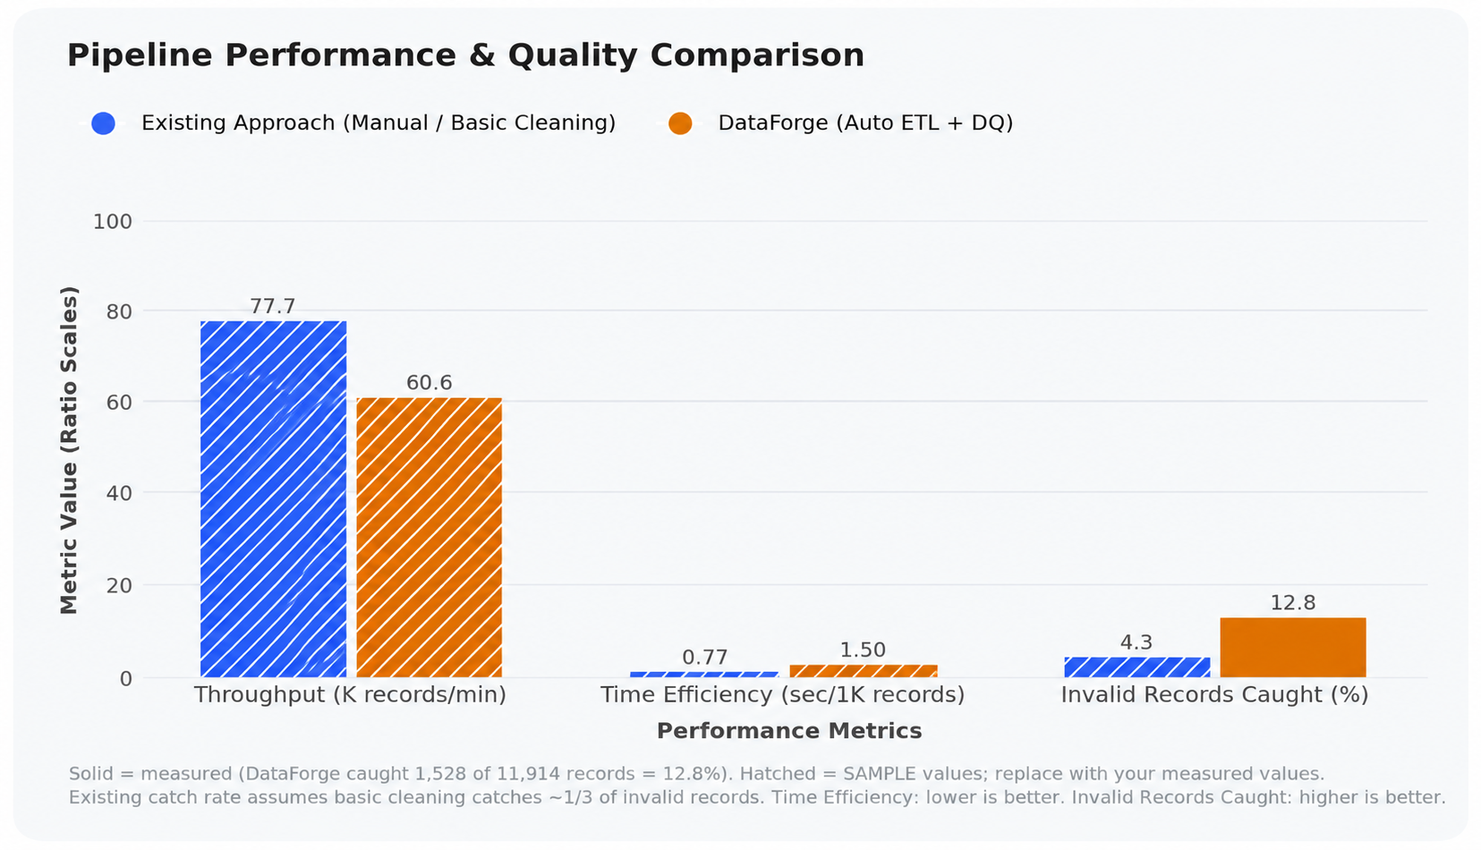

Slide 18
Comparison: Existing Approach vs DataForge
Performance Metric | Existing Approach | DataForge | Comparison | Performance Metric
Throughput | 77.7 K records/min | 60.6 K records/min | Existing approach is faster | Throughput
Time Efficiency | 0.77 sec/1K records | 1.50 sec/1K records | Existing approach is faster | Time Efficiency
Invalid Records Caught | 4.3% | 12.8% | DataForge detects more invalid records | Invalid Records Caught

Slide 19
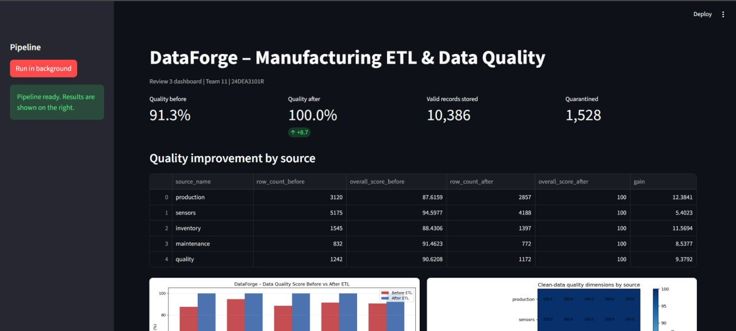
Results

Slide 20
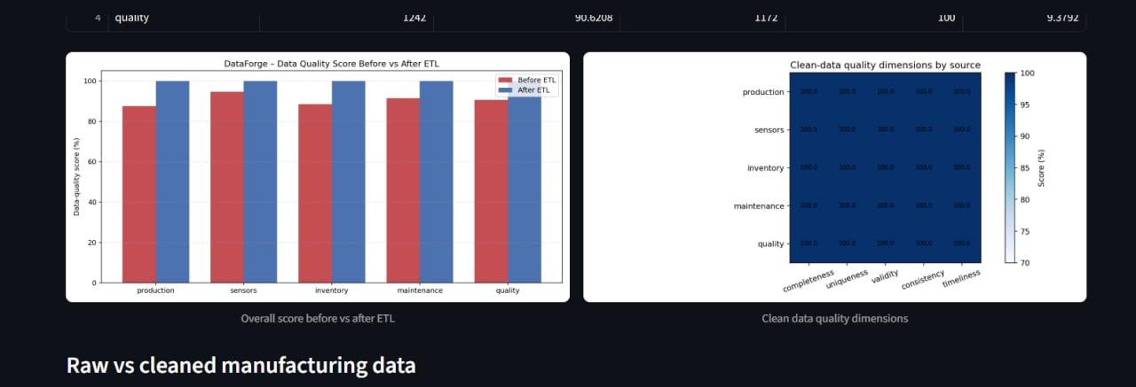

Slide 21
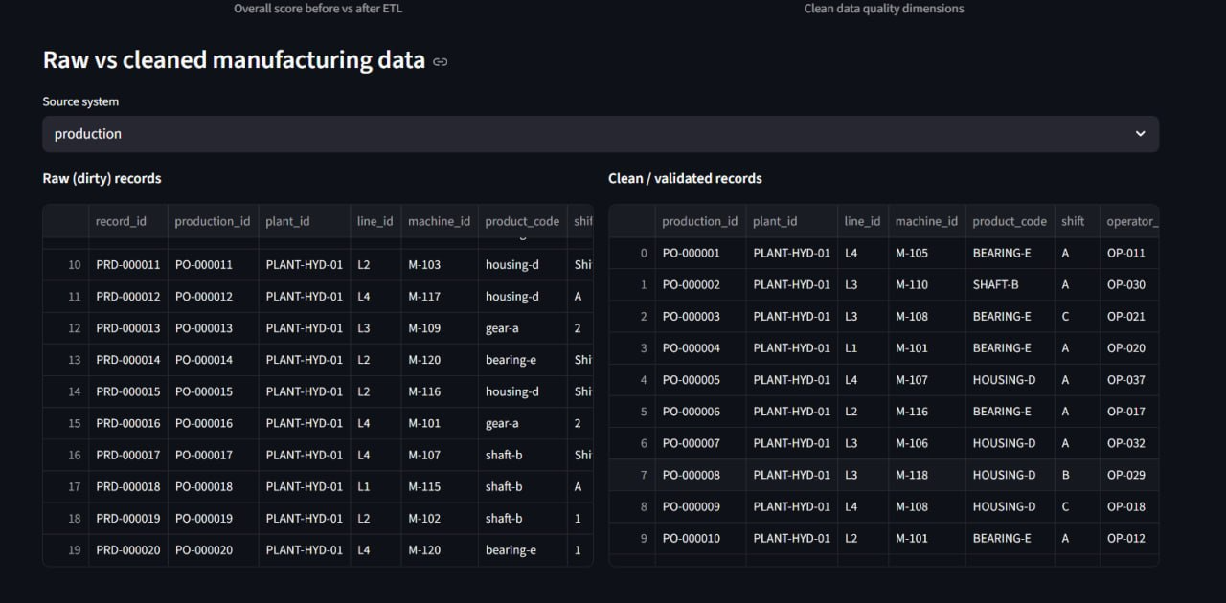

Slide 22
Conclusion
DataForge automates the manufacturing data-processing and ETL process and performs automated data-quality checks for missing, duplicate, inconsistent, and invalid records. It achieves a throughput of 60.6 K records/min, compared with 77.7 K records/min in the existing approach, and takes 1.50 sec/1K records compared with 0.77 sec/1K records. DataForge detects 12.8% invalid records, compared with only 4.3% in the existing approach, and the demonstrated implementation improved data quality from 91.3% to 100%. Although DataForge introduces some processing overhead, it provides better error detection and data reliability. Overall, the system produces clean, validated, and analytics-ready manufacturing data, focusing more on data quality and reliability rather than only processing speed.

Slide 23
References
[1] Hramov, Alexander E., and Alexander N. Pisarchik. "Big data management and quality evaluation for the implementation of AI technologies in smart manufacturing." Applied Sciences 15.22 (2025): 11905..
[2] Abdelrahman, Abdelrahman A., et al. "DataForge: An AI-Driven Data Warehouse Schema Generator." 2025 Twelfth International Conference on Intelligent Computing and Information Systems (ICICIS). IEEE, 2025.
[3] Mahmud, Danish, and Md Zafor Ikbal. "The role of etl (extract-transform-load) pipelines in scalable business intelligence: A comparative study of data integration tools." ASRC Procedia: Global Perspectives in Science and Scholarship 2.1 (2022): 89-121.
[4] Machireddy, Jeshwanth Reddy. "Data quality management and performance optimization for enterprise-scale etl pipelines in modern analytical ecosystems." Journal of Data Science, Predictive Analytics, and Big Data Applications 8.7 (2023): 1-26.
[5] Gaddipati, Soma Sekhar. "AI-Augmented Data Engineering: Enhancing ETL Pipelines with Intelligent Automation and Data Quality Frameworks." Journal of Electrical Systems (2021).

Slide 24
THANK YOU

